Slide 1
Centralized Management and Tracking: Design and Implementation of a Satellite Database
Student: Darko Ivanoski, 4660
Instructor: Venera Gudachi, PhD
Notes:
In this presentation, we will discuss the design and implementation of a comprehensive satellite tracking database built using SQL Server Management Studio 2019. The exponential growth of satellites orbiting Earth necessitates robust systems for tracking their location, health, and mission status. This centralized repository offers functionalities critical for diverse applications, including satellite communications companies, space research institutions, and amateur astronomers.

Slide 2
The Problem
Exponential growth of satellites in orbit
Difficulty in managing data from various sources
Data redundancy and inconsistency
Notes:
The number of satellites orbiting Earth is growing rapidly. This has created a challenge for organizations that need to track and manage this data. Currently, data is often scattered across different sources, which can lead to redundancy and inconsistency. A centralized database can help to solve this problem.

Slide 3

The solution
Centralized repository for satellite data
Stores information such as:
Satellite identification
Launch information
Orbit data
International Identification
Notes:
A satellite tracking database can provide a central repository for all relevant satellite data. This database can store information such as satellite identification, launch information, orbital data, health status, and mission objectives. This will allow users to easily access and manage all of the data they need in one place.

Slide 4
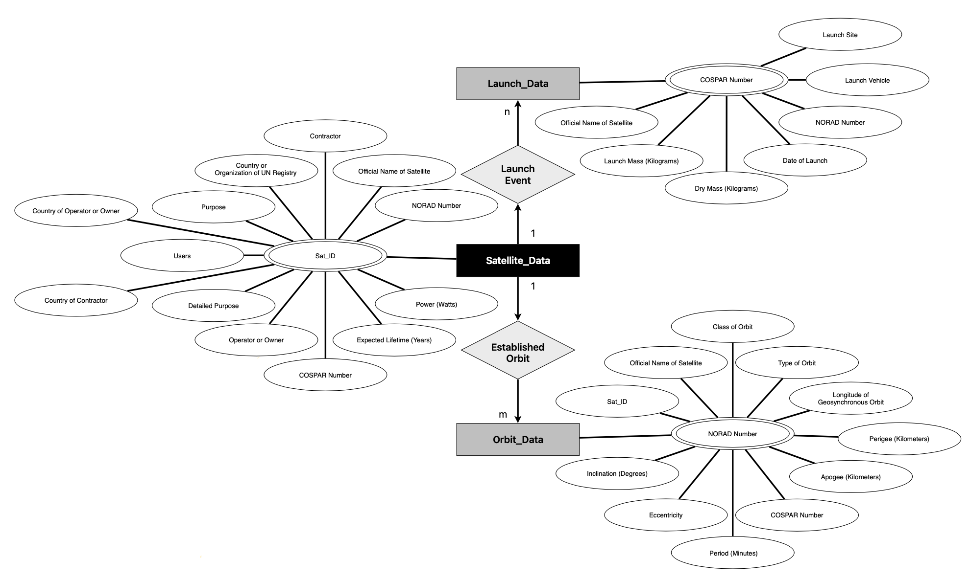
E-R Diagram
Entity-relationship (E-R) diagram depicts the relationships between database entities
Notes:
This slide illustrates the Entity-relationship (E-R) diagram of the satellite tracking database. The E-R model provides a visual representation of the relationships between the different entities (data objects) within the database. In this case, the core entities are Satellite, Launch, and Orbit. The relationships between these entities are critical for understanding how the data is organized within the database.

Slide 5
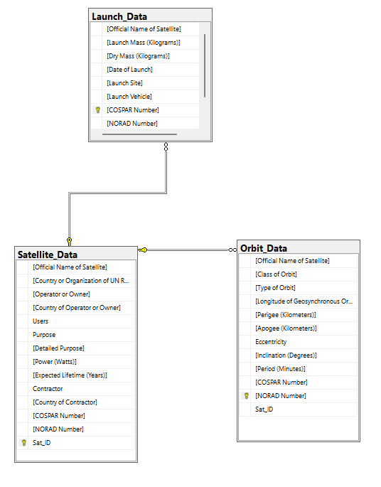
Diagram of Tables and Documentation of Tables
Three tables house specific data categories:
Satellite_Data: Core information about each satellite
Launch_Dara: Details pertaining to the launch event
Orbit_Data: Specifics of the satellite’s orbital path
Notes:
The satellite tracking database is comprised of three relational tables: Satellite_Data, Launch_Data, and Orbit_Data. Each table is designed to store specific categories of data. The Satellite_Data table serves as the core repository, containing general information about each satellite. The Launch_Data table stores details about the launch event for each satellite. Finally, the Orbit_Data table houses specific details concerning the orbital path of each satellite. Foreign keys are used to establish relationships between the tables, ensuring data integrity.
—
This slide delves deeper into the structure and purpose of each table within the satellite tracking database. We will explore each table’s columns and the types of data they contain. Understanding the structure of these tables is essential for effectively utilizing the database.

Slide 6
Thank you for your attention!
References: Union of Concerned Scientists (2017), Active Satellites in Orbit Around Earth

